Slide 1


Development and Growth of Private Universities
Implications for Access, Equity and Sustainability
By:
Dr. Lucy Agyepong,
Dr. Abena Engmann,
Prof George Bob-Milliar

Slide 2


Outline
Introduction and Background
Historical Development and Growth in Private Universities
Current Landscape in Private Higher Education Institutions
Role in Expanding Access and Promoting Equity and Sustainability
Role in Contributing to Economic and Social Development
Challenges
Future Prospects of Private Institutions
Key Recommendations for Policy and Practice
Conclusion

Slide 3
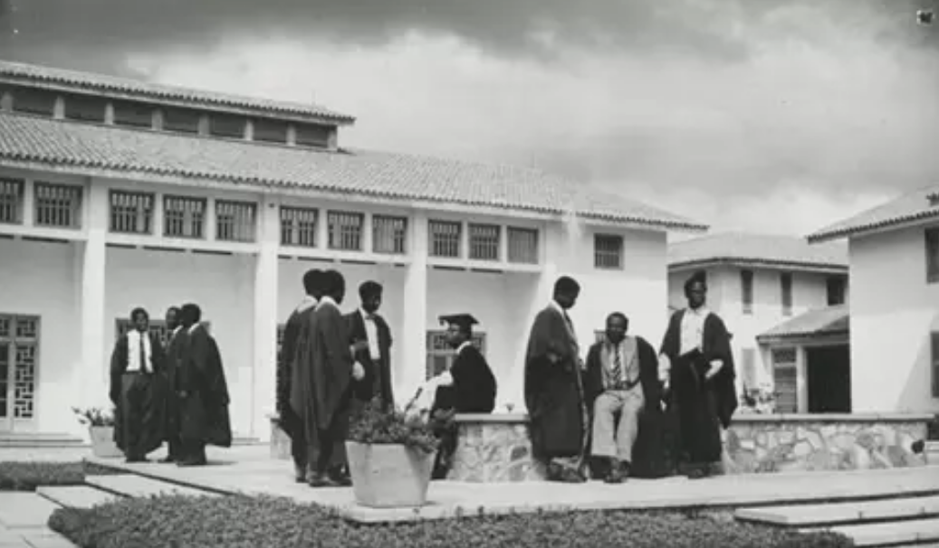
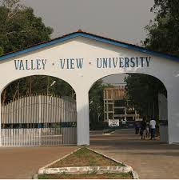

Introduction and Background
The introduction of private universities in the late 20th century saw the most noteworthy changes in higher education in Ghana
  1979 – establishment of Valley View University
  To the surge in private Higher Educations Institutes (HEIs) in the late 1990s to early 2000s.
Notes:
Increase demand for tertiary education through population growth an increase in enrollment numbers in tertiary institutions due to the increase in products from basic through senior secondary schools.
And this was welcomed, because private institutions were expected to:

Slide 4

Introduction and Background
Liberalization policy of the 1980s
Suggestion from the University Rationalization Committee (1983-1987)
Increased demand for tertiary education that public institutions were unable to meet
As well as education reforms in the mid 1990’s led to the birth and surge of private institutions in Ghana
  Increase quality in tertiary education
  Bridge the gap in infrastructure and access
  Groom young people to become top-notch scientists and business entrepreneurs through specialized programmes and curricula designed to appeal to industry
Notes:
The growth in private HEIs was influenced by several factors: such as (read from slides)
And this was welcomed, because private institutions were expected to:

Slide 5
Introduction and Background
There was an expectation that private universities will make public universities unattractive to those who desired to have a more personalized learning environment and development, and aspire for more academic excellence.
This expectation boosted the popularity of private universities among the teeming youths in the early 2000s, becoming the preferred choices for the children and wards of some of the elite and middle-class Ghanaian
The image of private universities reached its plenitude when some received high ratings by internationally renowned assessors e.g. Valley View and Ashesi - world class universities

Slide 6
Introduction and Background
Some studies have documented the challenges faced by private universities particularly around financial sustainability, infrastructural challenges, limited faculty while still keeping educational standards and regulatory requirements
Their survival and resilience has been attributed to their affiliation with public universities
Others have contended that the operational difficulties tend to revolve around the founders and their small group of financiers.
Aim of the Background Paper: Analyze the development, growth, impact, challenges and future potential of private universities in Ghana.

Slide 7
Historical Evolution of Private Higher Education
Pre-1992:
1992-2000:
2000-2020:
2020 Present
Dominated by public institutions, with minimal private influence.
Foundational period with legal reforms, establishment of National Accreditation Board (NAB) and National Council for Tertiary Education (NCTE).
Regulatory improvements and establishment of Ghana Tertiary Education Commission (GTEC).
Expansion and increased role of private institutions in providing accessible education.
Notes:
The Historical evolution of Private Higher Education can by categories into four distinct key periods:

Slide 8
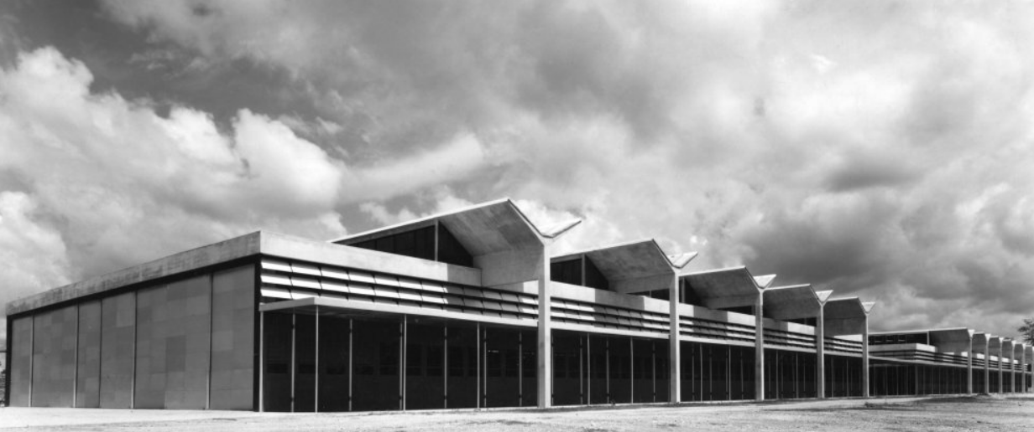
Historical Evolution of Higher Education in Ghana
Foundations in Colonial Era:
  Initial higher education focused on training for colonial administration.
  1948: University College of the Gold Coast (now University of Ghana) established with support from the University of London.
Post-Independence Expansion (1957-1980s):
  Kwame Nkrumah’s push for an Africanized, technically-focused education to drive industrialization led to the creation of Kumasi College of Technology which was upgraded into the University of Science and Technology (now KNUST) in 1961, followed by the establishment of University of Cape Coast in1962
  Shift towards tuition-free public universities to promote access.
Notes:
Images and pictures university college of Gold Coast / UG and Kumasi College of Technology (UST) and University of Cape Coast
across most of the slides

Slide 9
Historical Evolution of Higher Education in Ghana
Foundations in Colonial Era:
  Initial higher education focused on training for colonial administration.
  1948: University College of the Gold Coast (now University of Ghana) established with support from the University of London.
Post-Independence Expansion (1957-1980s):
  Kwame Nkrumah’s push for an Africanized, technically-focused education to drive industrialization led to the creation of Kumasi College of Technology which was upgraded into the University of Science and Technology (now KNUST) in 1961, followed by the establishment of University of Cape Coast in1962
  Shift towards tuition-free public universities to promote access.
Notes:
With the establishment of University College of Gold Coast through the recommendations of the Elliot and Asquith Commission (Images and pictures university college of Gold Coast / UG and Kumasi College of Technology (UST) and University of Cape Coast)

Slide 10
Historical Evolution of Private Higher Education
1980s - 1990s Reforms:
  Economic challenges led to end of free tuition for the three public universities
  Economic Recovery Program (ERP) under Structural Adjustment Programs (SAPs) opened up higher education sector to private sector participation (in 1987) with the gradual deregulation of public higher education.
  Little uptake of private participation until the education reforms seen in the early 1990’s
  1992 Constitution of Ghana created several regulatory bodies for the higher education sector
  1993: Establishment of National Accreditation Board (NAB) to regulate and support private institutions, and National Council for Tertiary Education (NCTE) an advisory body to liaise between government and higher education institutions in Ghana

Slide 11
Historical Evolution of Private Higher Education
Modern Growth of Private Universities (1990s-Present):
  Enabled by 1992 Constitution and demand for specialized programs, the government established a number of public universities across the nation
  At the same time private institutions increased in numbers
  As of January 2020, NAB had accredited over 70 private universities , including
    Central University, Methodist University, All Nations University College, Catholic University College of Ghana, Islamic University College, Presbyterian University College, Wisconsin University College, Valley View University College and Ashesi University College among others.

Slide 12
Historical Evolution of Higher Education in Ghana
2
●1992: Constitution (Enshrined educational rights)
●1993: National Accreditation Board (NAB) & National Council for Tertiary Education (NCTE) formed (NCTE was formed to be a regulatory body to help the government oversee tertiary education while setting guidelines for the institutions. NAB was set up to be an accreditation body that monitored institutions for quality assurance (Utaka, 2008: Armah, 2022))
Post-1992
Key Milestones
1
Pre-1992
3
2000-2012: Regulatory Refinements
●2000: GETFund established (to provide financial support to education at all levels)
●2003: Education Strategic Plan (2003 - 2015)
●2007: National Accreditation Board Act
●2007: Polytechnics Act (Polytechnics became tertiary institutions with academic autonomy)³
●2012: Colleges of Education Act, 2012 (Act 847) (Elevated teacher training colleges to tertiary status, and designated them as Colleges of Education)
●1948: Elliot and Asquith Commissions led to the establishment of University of Ghana
●1951: Accelerated Development Plan of Education
●1961: Education Act (to ensure compulsory primary and middle school education for all children of school-going age)
●1973: Dzobo Committee (Reduced pre-university education to 13 years)
●1980s: Bretton Woods Institutions (Liberalisation of education and economy)
●1987: PNDC Reform (Reduced pre-university duration to 12 years)
●1988: University Rationalisation Committee (Developed a framework for reforming management, academic structure & funding of tertiary education in Ghana.)
4
●2016: Technical Universities Act 2016 (Act 922) (Amended in 2018, the act came to convert qualified polytechnics to Technical Universities)
●2018: Updated Education Strategic Plan (from 2018-2030)
●2020: Education Regulatory Bodies Act (NAB & NCTE merge into GTEC)
2012–Present

Slide 13
Current Landscape of Private Higher Education
Private Tertiary Institutions Offering HND/Degree Programmes
108
Chartered Private Tertiary Institution
12
As of 2024 GTEC has accredited over140 private tertiary institutions, including universities (12 chartered) and university colleges, polytechnics and colleges of education.
Private Nurses Training College
14
Private Polytechnic
1
Private College of Education
4
Distance Learning Institution
2
Total
141

Slide 14
Current Landscape of Private Higher Education
Typologies of Private Universities
Classification by Ownership
  Faith Based Institutions (such as Central University, Pentecostal University, Valley View University, Catholic University, Methodist University, All Nations University among others)
  Private Owned Institutions (Ashesi University, Academic City University College, Radford University College, et al)
Classification by Business Model
  For Profit Institutions (e.g. Lancaster University Ghana, Radford University College, Knutsford University College, Academic City University College, African University College of Communications)
  Not for Profit Institutions (e.g. Ashesi University, Central University, Pentecost University, faith based institutions to name a few)
Differentiation
  Governance and Curriculum often influenced by the founding organization (e.g. religious, private owners)
  Interdisciplinary programmes more common in private universities
  Contribution to access and filling gaps in public higher education

Slide 15
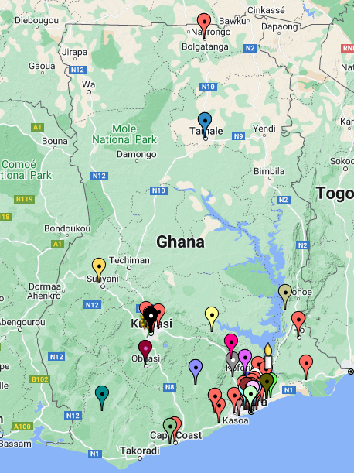
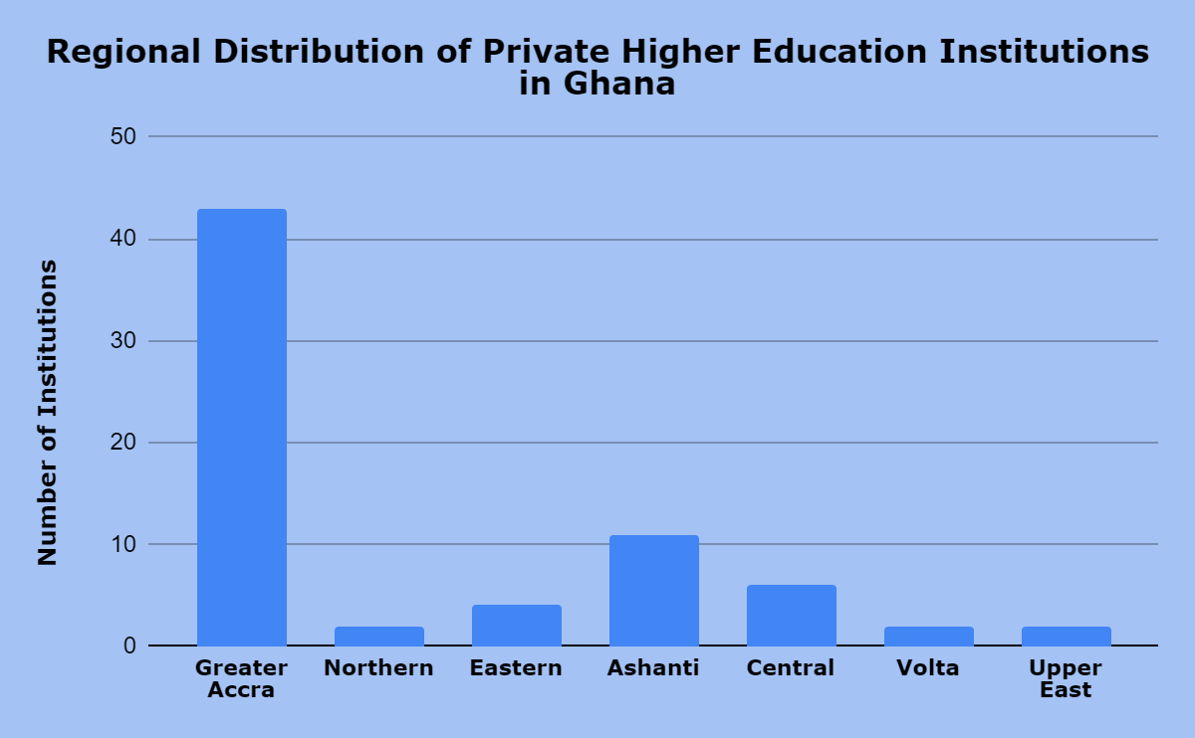
Current Landscape of Private Higher Education
Distribution: Predominantly in urban areas, with 50% located in Greater Accra and southern Ghana.
  Advance Global College (Tamale)
  Millar Institute For Transdisciplinary And Development Studies (Bolgatanga)
Source: GTEC, Institutions with Active Accreditation, 2024
Notes:
Ayelazun and Aziabah (2021) attribute this to the northern-southern equality gap in Ghana. With the regions in the south of Ghana being more economically advanced, private higher education institutions find it more financially sustainable and investment worthy
This trend is similar to public universities with 57% located in the coastal belt, 19% in the middle belts and 24% in the northern belt.

Slide 16
Current Landscape of Private Higher Education
Enrolment Trends:
  Increase in the number of private HEIs has not translated into increase in student enrollment
  Apart from the initial uptake in enrollment in 2011/2012, enrollment in private tertiary institutions has been consistent in terms of new entrants
  As of 2023/2024 the total student enrollment for private higher education was at 70,557
  Public institutions have always had higher enrollment numbers
  Significant rise in enrolments, following the graduations of the first beneficiaries of the free SHS policy and the expansion of public offerings to distance education, fee paying options for highly subscribed programmes and establishment of satellite campuses as part of their postCOVID-19 impact recovery.
Notes:
With some periods of growth and some periods of decline.

Slide 17
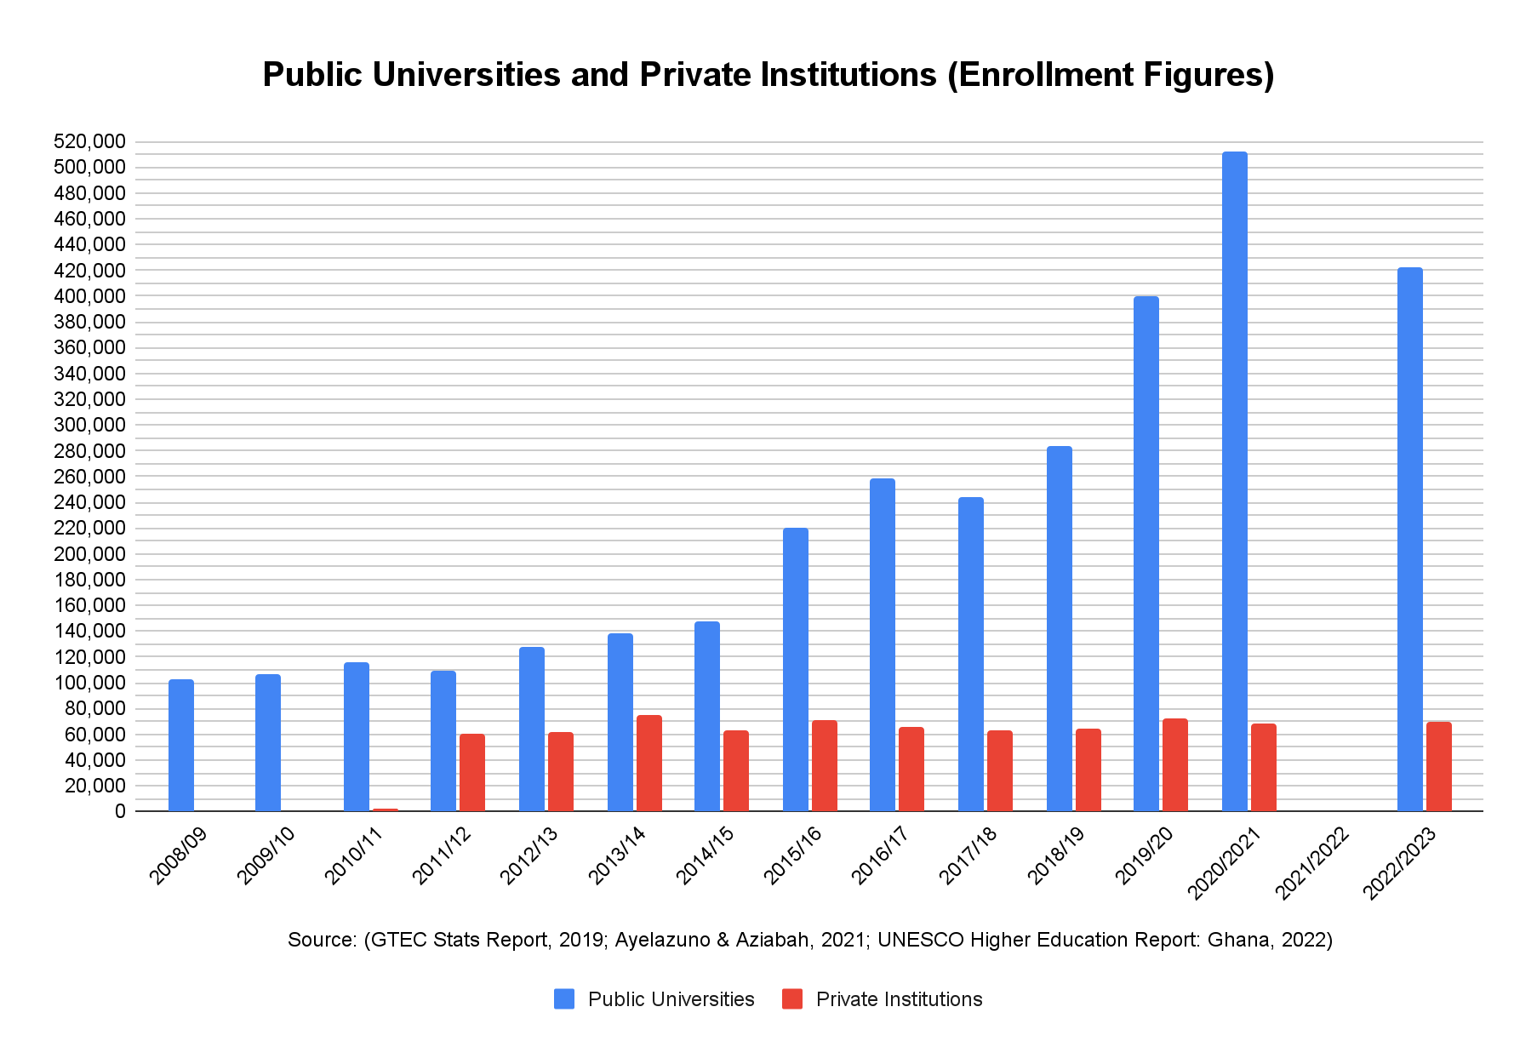
Current Landscape of Private Higher Education
2020/2021 saw the highest disparity between public universities and private institutions, 88% vs 12% of a total enrollment of 580,751 students
Enrolment by Gender (Male to Female ratio)
GTEC Norm | Public HEIs | Private HEIs
50:50 | 54:46* | 43:57
Source: GTEC 2024 for Private HEI and predicted* for Public HEI based on GTEC statistical data 2015-2021
Notes:
This trend can be attributed to several factors. Although smaller class sizes and the interactive nature of learning at private HEIs make them an appealing alternative to public institutions, the higher cost of private education compared to public options remains a significant barrier. This financial challenge is a key reason why enrolment has not seen substantial increases and, in some instances, has even declined though the population of graduating students from senior high schools keep increasing.

Slide 18
Current Landscape of Private Higher Education
Programme offerings
  Universities offer a diverse range of courses/programmes
  Categories broadly into Science related programmes and Humanities-related programmes
  Although some institutions have made significant contributions to STEM education
    Academic City’s innovative BSc Artificial Intelligence and Robotics Engineering
    Ashesi University’s BSc Mechatronics and Computer Engineering programmes
    Central University’s BSc Physician Assistantship and Doctor of Pharmacy
  Both Private and Public HEIs have been unable to achieve the GTEC norm of 60:40 ratio for Science to Humanities related courses.
Source: GTEC 2018/2019 Statistical Reports
Notes:
Science related including agriculture, science, applied sciences and engineering
Humanities comprising of Arts, Social Sciences, Business and Education
.This could be attributed to the lower number of students studying science-related programmes at Senior High School as well as the infrastructural demand and resource intensive nature associated with offering STEM related courses at the tertiary level.
.

Slide 19
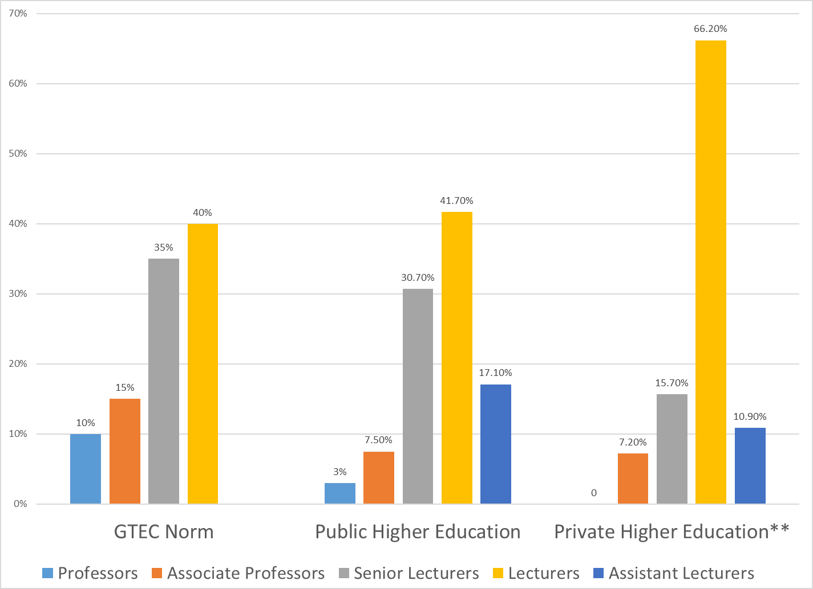
Current Landscape of Private Higher Education
Staffing Statistics
  Historically private institutions have been heavily reliant on part-time academic staff due to cost constraints
  Challenge in attracting and retaining high ranking full-time academic staff
Source: GTEC 2018/2019 Statistical Reports
Notes:
Although public institutions have larger staff numbers compared to private universities, they too have been unable to meet the academic staffing pyramid requirements set by GTEC.

Slide 20
Current Landscape of Private Higher Education
Governance Structure
  Internal governance structure of private universities (particularly chartered ones) are similar in structure to the governance structure of public universities, but with a higher percentage representation of the institution’s founders or owners on the Governing Council or Boards
  Faith based institutions (such as Valley View University, Methodist University and Pentecost University) have several of the council members representing the church or religious body
  There is a strong external representation (from both academic and industrial backgrounds) appointed in partnerships with the founders

Slide 21
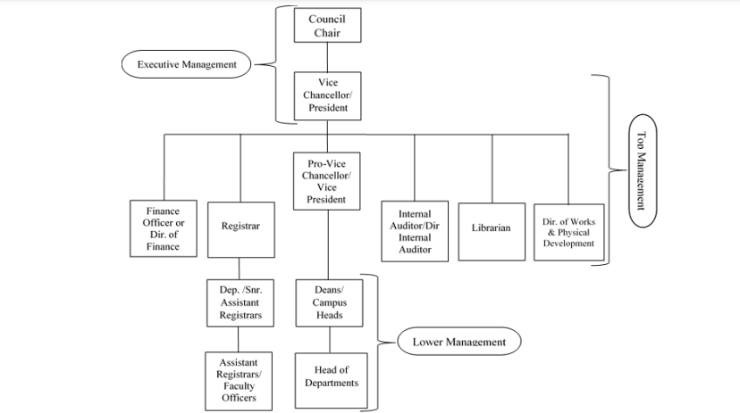
Current Landscape of Private Higher Education
Governance Structure
  Similar to public higher educations, the functions of the governing council are similar
  Unlike public higher education systems some private institutions have no student representation while others do (e.g. Ashesi Board of Directors with no student representatives, Academic City’s Governing Council with Student representatives)
Hierarchical Structure of Leadership in private Higher Education Institutions

Slide 22

Current Landscape of Private Higher Education
Business Models and Financial Sustainability
Primarily tuition-dependent;
  Limited access to government support means tuition is the primary revenue source, making private institutions financially vulnerable. (e.g. Catholic University 95% funding from tuition)
  Declines in enrolment due to competition directly impacts financial stability.
Most faith-based private higher education institutions also 0receive support from their parent organisations.
  Others like the Islamic University College Ghana and All Nations University receive donations and grants from abroad to cover close to 50 - 70% of operation costs (Varghese, N.V. et al, 2006).
Ashesi University has the Ashesi University Foundation, a registered non-profit that spearheads its fundraising to support the school’s mission.
Further, international partnerships with funding agencies and charities such as MasterCard Foundation also support and fund the needs of some private higher education institutions e.g. Ashesi.

Slide 23
Current Landscape of Private Higher Education
Sources of Funding
In Ghana, the main sources of funding for public higher education institutions include Government grants, GETFund, development and donor partners, internally generated funds and private sector support, (Awotwe et al, 2020).
  The cost and funding for public higher education institutions is regulated by the Ghana Tertiary Education Commission, who advises the Ministry of Education on issues of finance.
Private institutions are heavily reliant tuition and academic user fees.
Some private higher education institutions receive research funding and participate in donor-funded projects by regional and international organisations as a source of funding beyond tuition revenue.
Partnerships with industry on multiple projects are also a source of funding for private higher education institutions in Ghana. Some of these partnerships come in terms of scholarships, projects.

Slide 24

Role in Expanding Access and Promoting Equity and Sustainability
Private universities serve as alternative pathways
  Increased access for people who otherwise would not have gained admission to public universities, due to limited admissions quota by public universities
  Evening and weekend classes provide flexibility, supporting working adults and non-traditional students
  Smaller student to staff ratios
Impact on Marginalized Groups
  Private universities see higher enrolment among female students, helping improve gender parity.
  Targeted scholarship programs for low-income students and female students, though limited in scope.

Slide 25
Role in Expanding Access and Promoting Equity and Sustainability
Curriculum Innovation
  More market oriented and future ready programs (e.g. Industrial and Systems Engineering, Artificial Intelligence and Robotics Engineering by Academic City, 1st in sub-Saharan Africa)
  Strong focus on entrepreneurship training at the core of their curriculum.
Equity Challenges:
  The concentration of institutions in urban areas limits access for rural populations.
  Institutions concentrated in economically advanced southern regions, limiting access for those located in the northern areas
  High tuition costs present affordability barriers, particularly for lower-income families​

Slide 26
Role in Contributing to Economic and Social Development
Economic Impact:
  More access to higher education through private institutions means young people get the requisite skills join active workforces.
  Job creation within universities, through faculty and staff roles, and indirectly in the surrounding communities
  Partnerships with industry for internships and applied training to meet labor market needs.
  Employment creation through the practical teaching and training in entrepreneurship hubs and innovation centres (e.g., Academic City’s innovation centers).
Social Impact:
  Programs focused on ethics, entrepreneurship, and social responsibility. (e.g. Academic City and Ashesi university promotes leaderships and Ethics)
  Enhanced opportunities for disadvantaged groups, and increase in local community projects and engagement.
    E.g. Ashesi University’s alumni projects impacting local communities (e.g., WACCE, community libraries). Academic City’s partnership with Vodafone Foundation to train 50girls (some with disabilities) in STEM and Waste Recycling

Slide 27
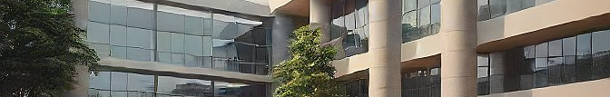
Financial Sustainability and Funding Challenges
Sustainability Challenges:
  Competition with public universities for the same crop of students,
  Higher operation costs due to investment in state of the art laboratories for small class sizes and regulatory costs
  Economic instability have a direct impact tuition costs
  Limited scholarship funding restricts access for students without financial means (i.e. low income students), hindering local equity efforts, therefore attracting more and more student from international communities
  Tuition reliance limits resources for research and faculty development, affecting institutional growth and graduate quality Opportunities:
Opportunities
  Diversification of revenue through alumni donations, partnerships, grants and university-led ventures

Slide 28
Staffing and Faculty Challenges
Recruitment Challenges:
  Financial limitations hinder the recruitment of qualified PhD holders; salaries are often uncompetitive.
  Heavy reliance on part-time and adjunct faculty, affecting teaching consistency and quality.
Workload and Quality:
  Over-reliance on part-time staff can negatively impact teaching quality, particularly in research and supervision-heavy courses.
Opportunities
  Cost-sharing models for highly specialized faculty across institutions.
  Incentives for diaspora scholars to teach in Ghana, including tax waivers and reduced bureaucracy
Notes:
Policy Suggestions:
Cost-sharing models for highly specialized faculty across institutions.
Incentives for diaspora scholars to teach in Ghana, including tax waivers and reduced bureaucracy

Slide 29
Policy and Regulatory Landscape and Challenges
Accreditation and Quality Assurance:
  GTEC oversees quality and accreditation of all private institutions
  NAB/GTEC mandates affiliation with chartered public institutions before granting full accreditation to private universities. (which comes with its associated affiliation and regulatory fees)
COVID-19 and Hybrid Learning:
  Increased hybrid learning demands oversight and quality control to ensure consistency.
Challenges with Mentorship:
  Limited capacity of public institutions to provide mentorship to growing numbers of private institutions.
  Tensions with GTEC over accreditation, disparities between private and public institutions.
    Perceived stricter enforcement of accreditation requirements on private universities compared to public universities

Slide 30
Future Prospects for Private Universities
Creating Niches: Focus on specialized programs and emerging fields such as AI, cybersecurity and sustainable business practices to meet labor market demands
Collaboration Potential: Opportunities for partnerships with international institutions, industry collaborations for research and funding.
Improving Equity: Expanding regional access through satellite campuses or scholarships targeting underserved regions to improve access.
Increase potential to rival top public institutions with strategic investment in faculty and research capacity
Notes:
Suggested Image: Diagram illustrating niche specialization; map indicating potential expansion regions.

Slide 31

Key Recommendations for Policy and Practice
Enhanced Funding Opportunities:
  Policies to incentivize private sector investments in education, including tax breaks for donations.
  Funding framework Reform:
    expand access to public funds (GETFund) or similar grants for private institutions with accountability metrics
  Developing a stronger financial aid system (student loans options) for students in private institutions to enhance equity
  Promote income diversification through alumni engagement and external partnerships

Slide 32

Key Recommendations for Policy and Practice
Research and Development Support
  Providing government-backed grants for research and infrastructure projects
  Partnerships with international organisations to expand research opportunities and facilitate capacitate building
  Encourage government-industry partnerships to support specialized programs and research
Faculty Recruitment and Development
  Implement shared staffing models
  Create incentives for diaspora scholars
  Provide training and development programmes to enhance teaching quality and assist with retention

Slide 33
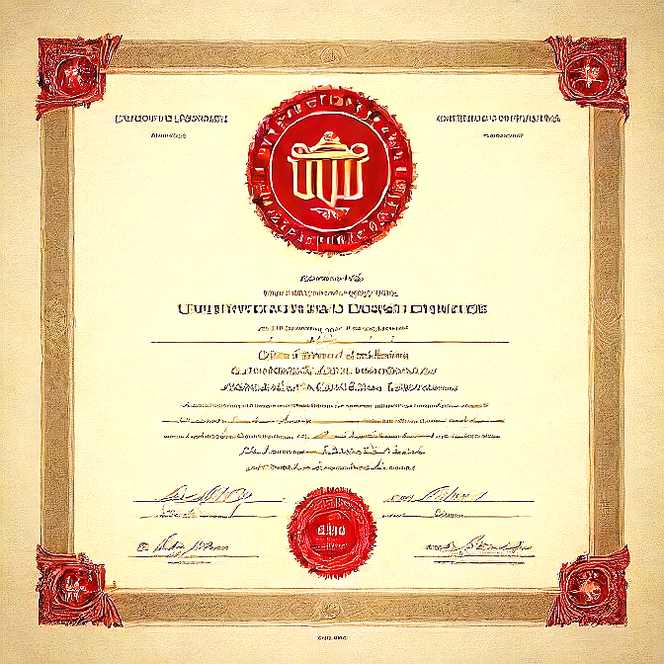

Key Recommendations for Policy and Practice
Policy Reforms
  Adjustments to enable private institutions’ growth without undermining their role in education.
  Emphasis on creating equitable policies that ensure both public and private institutions can thrive without disadvantaging each other
  Amendments to policies for private institutions to access public funding, clearer mentorship frameworks for accreditation

Slide 34

Key Recommendations for Policy and Practice
Regulatory Reforms
  Streamline the accreditation process: reform affiliation requirements
  Develop clearer guidelines for route and application to presidential charter
  Collaborative regulatory models that encourage innovation whilst safeguarding quality standards

Slide 35
Conclusion
Private higher education has played a vital role in expanding access to tertiary education in Ghana
Addressing funding, faculty recruitment, and regulatory challenges is essential for their sustainability.
Supportive policies and partnerships will allow private universities to further contribute to Ghana’s national development goals
Despite challenges private universities are positioned to contribute significantly to national development

Slide 36

Key Observations in Conducting this Research
Scarcity of Recent Data
Data Limitations:
    Latest available data from the Ghana Tertiary Education Commission dates to 2019, making it challenging to capture the true current state of Ghana’s private higher education accurately.
    Reliance on secondary sources from past studies may affect the analysis’s relevance to present-day dynamics.

Slide 37
Key Observations in Conducting this Research
Historical Nature of Literature
Outdated Research:
  Much of the foundational literature on Ghana’s higher education is from 2004-2006.
  This highlights a research gap, emphasizing the need for up-to-date and comprehensive studies in the sector.

Slide 38
Recommendations for Future Research
Primary Research Needs:
  Conducting new, in-depth primary research with current statistics and insights on private higher education in Ghana is essential.
  More recent studies will support more accurate analysis and policy recommendations
Improving Data Collection and Accessibility
Encouraging Regular Data Updates:
  Authorities, such as the Ghana Tertiary Education Commission, should be encouraged to publish frequent statistical reports.
  Up-to-date data accessibility will enable timely and reliable analyses to inform educational policy and planning.

Slide 39

Development and Growth of Private Universities
Authors:
Dr. Lucy Agyepong,
Dr. Abena Engmann,
Prof George Bob-Milliar.
Thank You

