Slide 1
MAKING THE GETFUND FIT FOR PURPOSE
PROF KOFI OSEI-FRIMPONG
ASSOCIATE PROFESSOR
AFRICA BUSINESS SCHOOL
UNIVERSITY MOHAMMED VI POLYTECHNIC
RABAT, MOROCCO

Slide 2
Presentation outline
Introduction
State of higher education institutions financing
The structure of cost of higher education
Funding model in tertiary education in Ghana
Management of GETFund
The role of GETFund in higher education development
Criteria for funding by GETFund
Key challenges
Recommendations on making GETFund fit for purpose
Conclusion

Slide 3
Introduction
Financing public higher education institutions in Ghana has become a subject of discussion, given recent declines in government funding.
2024 budget allocation of GH¢32.7 billion to the Ministry of Education is inadequate (this represents 14.5% of projected government expenditure – lower than 2023 SSA average of 15.5%, and UNESCO’s minimum target of 20%
This decline is mostly manifested in several areas, including:
Total public expenditure on higher education,
Per student expenditure,
Share of total government budget expenditure, and
Inadequate research funding.
Higher education financing challenges in the country led to the establishment of Ghana Education Trust Fund (The GETFund) in 2000 by the Ghana Education Trust Fund Act, 2000, Act 581.

Slide 4
Introduction
Despite GETFund’s supports to HEIs,
there is still a huge funding gap in infrastructural development in public HEIs.
The recent implementation of the free SHS policy, and the increasing number of students
calls for a need to dialogue to find a sustainable solution to addressing the infrastructural challenges in our public higher education institutions.
GETFund is overwhelmed and needs to find innovative ways in carrying out its mandate
Government can increase their funding allocation, however, this approach might not be feasible given the current economic situation in the country.

Slide 5
Purpose
This paper provides an assessment of the scope of the GETFund’s role in building a sustainable higher education enterprise in Ghana.
It further highlights some of the challenges facing the GETFund
It also outlines recommendations that could help address these challenges and make the GETFund fit for purpose.

Slide 6
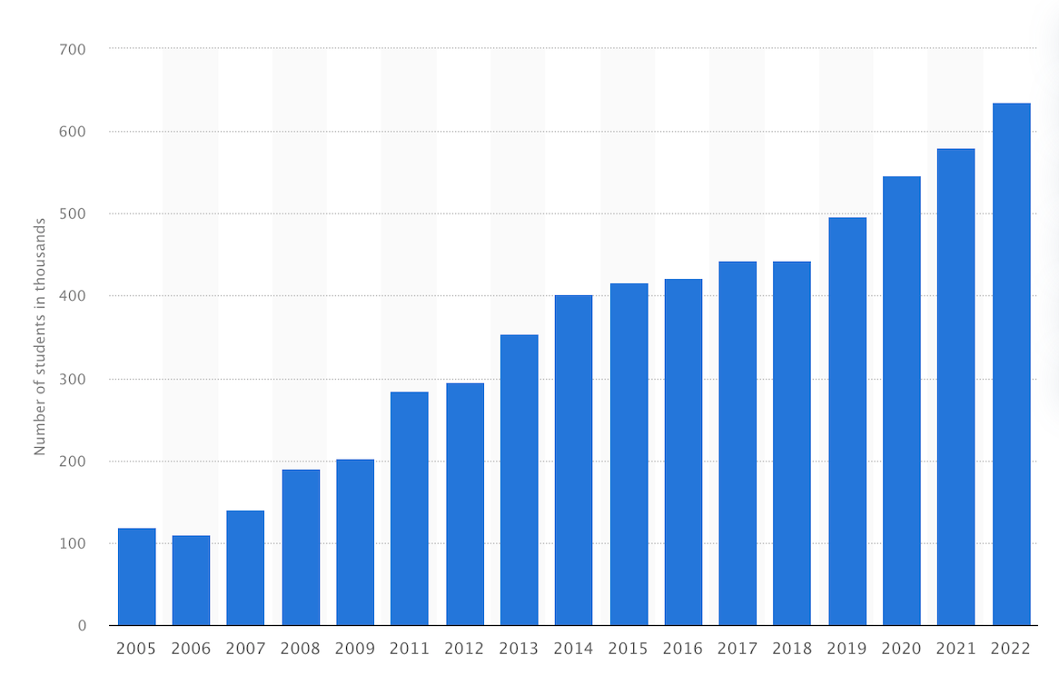
The state of higher education institutions financing
Higher education institutions typically rely on a combination of funding sources, which may include
government funding,
grants,
private donations, and
student tuition fees
Declining government funding in public higher education institutions
Increasing number of student enrolment
Ghana witnessed an enrolment of around 400,000 students in 2014, which increased to 635,000 in 2022, marking a substantial 58.75% increase in a period of six years
Cost sharing policy, performance funding policy, differentiated unit cost policy
Number of students enrolled in tertiary education in Ghana from 2005 to 2022

Slide 7
The structure of cost of higher education
The structure of cost of higher education in Ghana is influenced by the size of available funding from Government and donor agencies
Higher education in Ghana used to be free up until the early 1990s
As a result of low expenditure for higher education, government could not absorb the increasing expenditure due to increased student enrolment (Dadzie, 2009)
The Akosombo Accord in 1997 accepted the cost-sharing model of funding higher education in Ghana as follows:
Government: 70% payment of funding needs of tertiary education institutions;
Public universities: mobilise the remaining 30% funding requirements from three other sources including a) internal revenue-generation by the university, b) private donations, and c) students’ academic facility user fees.

Slide 8
Funding model in tertiary education in Ghana
The Ministry of Finance, through the Ministry of Education, has the responsibility of determining and approving fund allocations to HEIs annual expenditure items.
In public universities in Ghana, these expenditure items are categorised as:
staff compensation,
administration,
services, and
investment.
The Ghana Tertiary Education Commission (GTEC) coordinates and monitors the annual budget design and implementation in higher education institutions.

Slide 9

Management of the GETFund
The Ghana Education Trust Fund (GETFund) was established to provide funding to supplement government budgetary allocations at all levels of education (GETFund Act, 2000)
The board is responsible for managing the collection, accounting, and investment of the fund in accordance with the objective of the GETFund Act 581, 2000.
The Act 581 also requires the Board to be independent and also adopt innovative approaches in organising fund-raising activities to raise money for the fund.
  However, the independence of the Board is questioned given the subtle interference from Government.
Also, the over-reliance of funds from Government is a limitation to the operations of the GETFund, given the increasing number of the public higher education institutions.
This has often resulted in delays in receiving funds from Government leading to several operational constraints.

Slide 10
The role of the GETFund in higher education development
The primary objective of the GETFund is to provide financing to supplement the provision of educational activities especially at the tertiary levels.
Among other things the
Fund is designed to
(i) provide academic facilities and infrastructure to public institutions;
(ii) contribute money to support student loan scheme;
(iii) provide supplementary funding for needy students through the scholarship secretariat; and
(iv) support faculty development and research.
The GETFund contributes about 10% to 12.9% of Government expenditure in tertiary education institutions – this declined to 7.84% in 2023
The GETFund engineered the creation and establishment of the Student Loan Trust Fund (SLTF) in 2005 under the Trustee Incorporation Act 1962, Act 106.

Slide 11
Number of accredited tertiary institutions (GTEC, 2023)
Institutions | Number of Tertiary Institutions
 | Public | Private | Total
Universities | 15 | 91 | 106
Technical Universities/Polytechnic | 10 | 1 | 11
Colleges of Education | 46 | 2 | 48
Specialised Institutions | 8 |  | 8
Nurses Training Colleges | 68 | 10 | 78
Colleges of Agriculture | 4 |  | 4
TOTAL | 153 | 104 | 257

Slide 12
GETFund disbursement to tertiary institutions
Description | Year
 | 2018 GH¢ ‘000 | 2019 GH¢ ‘000 | 2020 GH¢ ‘000 | 2021 GH¢ ‘000
Scholarships | 81,488 | 78,104 | 94,077 | 61,649
Students Loans | 20,000 | 18,000 | 24,460 | 10,000
Faculty Development & Research | 2,329 | 2,025 | 2,958 | 1,467
Infrastructure Development | 78,247 | 106,338 | 188,131 | 122,764
Interventions/Programmes Tertiary | 77,611 | 5,000 | - | -
Vehicles, Accessories & Equipment | 20,904 | 6,078 | 19,193 | 1,312
Total Disbursed (Tertiary Sector) | 280,579 | 215,545 | 328,819 | 197,192
Total Disbursed Across all Sectors | 851,033 | 1,086,043 | 2,038,482 | 1,526,935
% Disbursed to Tertiary Sector | 32.96 | 19.85 | 16.13 | 12.91
Source: data compiled based on GETFund’s Annual Reports of the respective years

Slide 13

Criteria for funding by GETFund
The Ghana Education Trust Fund Act, 2000 Act 581 (section 8(1)) mandates GETFund to submit annually to Parliament for approval, a formula for the distribution of funds in respect of the following:
  Tertiary education
  Second cycle education
  Basic education
  Investment and
  Other related aspects of education such as distance education, school and public libraries and special education.

Slide 14
GETFund distribution formula for 2023
SUB-SECTOR | AMOUNT (GH¢) | PERCENTAGE (%)
Ministry of Education and Related Agencies | 97,540,000 | 4.50
Tertiary Education Sub-Sector | 170,000,000 | 7.84
Secondary Education Sub-Sector | 167,000,000 | 28.44
Basic Education Projects and Programs | 88,500,000 | 4.08
Parliamentary Support for Constituency Projects | 31,620,000 | 1.46
Digitalization of Teaching and Learning Systems | 550,000,000 | 29.41
Recovery of 2022 Shortfall | 619,690,000 | 33.14
TOTAL | 1,870,000,000 | 100

Slide 15
Overview of contributions of GETFund
The Fund has made some contributions in the areas of
infrastructure;
student development and support;
faculty research and development;
support for mathematics, science, and technical education; and
a robust support to the Ministry of Education and its agencies.
In spite of these contributions there are challenges that require innovative means to address

Slide 16
Key challenges
Payment of GETFund’s debt and commitments which have been pending for many years. Debts cleared up to December 2023 – current dept stands at approximately GH¢ 900 Million
From the initial focus on tertiary education, the GETFund now devotes a large proportion of its resources to the pre-tertiary levels.
The practice where limited resources are used to sponsor students for higher education in foreign countries using limited, scarce foreign resources and further deepening the balance of payment deficit needs to be reviewed.

Slide 17
Key challenges
The lack of independence and over-reliance on government for funding has often times caused delays and other budgetary constraints.
The passage (enactment) of the Earmarked Funds Capping and Realignment Act 2017, Act 947 has significantly affected the resource envelope of the GETFund.

Slide 18
Recommendations on making GETFund fit for purpose
Efforts should be made to introduce efficiency, reduce waste, and create value within the administration of the fund. GETFund needs some level of independence and autonomy to allow for selected projects to be worked on per year considering their limited resources.
The GETFund model requires a review to make it more effective and fit for purpose. This has not been done since the inception of the fund. The GETFund Act 2000, Act 581 should be reviewed periodically (e.g., every 5 years) and amended to help meet the current demands of the tertiary education sector
The Board should also adopt more innovative approaches in raising funds independent of the government. For instance, the GETFund could take an entrepreneurial approach to raising finance through a variety of mechanisms offered by the innovative financing drive for educational development.
Further, the GETFund should have a template that puts more emphasis on HEIs than the pre-tertiary sector. The current 12% fund allocation to public HEIs is inadequate.

Slide 19
Recommendations on making GETFund fit for purpose
A clear working policy must exist to focus on sponsoring Ghanaians within Ghanaian higher education institutions, especially for programmes offered in Ghana. Sponsorship for programmes abroad should relate to only critical needs of the country, and to programmes not offered in Ghana.
The GETFund may also develop a comprehensive public-private partnership framework that seeks to provide incentives to the private sector to drive the private sector to support tertiary education in Ghana.
Multiple stakeholder engagement is also recommended to help address areas of financing challenges and identify or explore other sustainable streams of income to support the Fund. To allow for timely release of funds, there is a need for GETFund levies to be directed away from the Consolidated Fund is strongly recommended.
Finally, the Earmarked Funds Capping and Realignment Act 2017, Act 947, should be further reconsidered by Government. Given the current financial situation of the GETFund, Government could uncap GETFund allocations and releases from the Ministry of Finance in the medium term.

Slide 20
Conclusion
In conclusion, the GETFund in the midst of the challenges should adopt innovative mechanisms in raising funds to support its activities and programmes.
There is a need to improve on their efficiency, develop entrepreneurship mindset at all levels within the administration of the Fund, and encourage public-private partnerships to drive more support from the private sector.

